Slide 2
Spatial Analysis and Visualization Chapter - 5
Ajaya Mishra
Sunday, December 13, 2015

Slide 3
Outlines
Spatial Analysis
Overlay
Buffering
Map outputs & Basic Elements

Slide 4
Spatial Analysis
Spatial Data:
it is the data or information that identifies the geographic location of features and boundaries on Earth , such as natural or constructed features, oceans , and more.
Spatial data is usually stored as coordinate and topology, and is data that can be mapped.
Spatial analysis is the process by which we turn raw data into useful information

Slide 5
Spatial Analysis
In GIS, there are 2 basic spatial data types
Raster
Vector

Slide 6
Spatial Analysis: What is it?
“…the purpose of geographic inquiry is to examine relationships between geographic features collectively and to use the relationships to describe the real-world phenomena that map features represent.” (Clarke 2001, 182).
One Definition: the quantitative procedures employed in the study of the spatial arrangement of features (points, lines, polygons and surfaces)

Slide 7
Spatial Analysis: What is it?
What types of relationships exist between geographic features, and how do we express them?
Process for looking at geographic patterns in your data and relationships between features.
Helps in better decision making affecting people, budgeting money and resources.

Slide 8
Spatial Analysis: What is it?
Spatial analysis can be:
Inductive: to examine empirical evidence in the search for patterns that might support new theories or general principles, in this case with regard to disease causation.
Deductive: focusing on the testing of known theories or principles against data.
Normative: using spatial analysis to develop or prescribe new or better designs.

Slide 9
Spatial Analysis
Spatial query
Where is Bernhardt College?
Show the BSC CSIT 8th semester classroom.
Select the best classroom.
Spatial Analysis
Where should one locate another branch of Bernhardt College?
How many students are passed out?
Identify some classrooms for best class.

Slide 10
Spatial Analysis: Application Areas
Environmental Analysis
Social Analysis
Hydrological Analysis
Agriculture Analysis
Forestry Analysis
Land-use Analysis
Many more…

Slide 11
Spatial Analysis Function
Maintenance & Analysis of spatial data
Maintenance & Analysis of Attribute Data
Integrated Analysis of Spatial & Attribute Data
Retrieval, classification and Measurement
Overlay Operations
Neighborhood Operations
Network and Connectivity Operations

Slide 12
Overlay Operations

Slide 13
Overlay Operations
Hallmark of GIS is overlay operations.
New spatial elements are created by overlaying of maps.
operation that combines different geographic layers to generate new information.
Done using Arithmetic, Boolean & Relational operators.
Standard overlay operators take two input data layers, and assume they are geo-referenced in the same system, and overlap in study area.

Slide 14
Overlay Operations
Principle is to compare the characteristics of the same location in both data layers, and to produce a result for each location in the output data layer.
In raster: comparisons are carried out between pairs of cells, one from each input raster.
In vector: comparing locations applies, but underlying computations rely on determining the spatial intersections of features from each input layer.

Slide 15
Vector Overlay
Map features and the associated attributes are integrated to produce new composite map.
Logical rules applied for combination
Performed on different type of map features.
Polygon-on-polygon Overlay
Line-on-polygon Overlay
Point-on-polygon Overlay
Attribute merged.

Slide 16
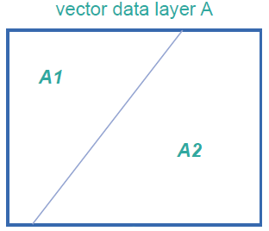
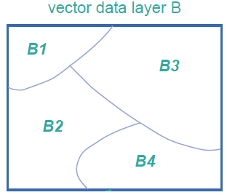
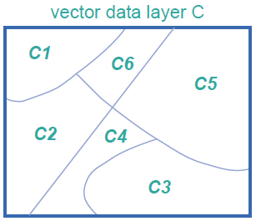
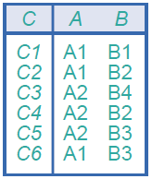
Vector Overlay
Two polygon layers A & B produce new polygon layer (with associated attribute table) that contains all the intersections of polygons from A & B

Slide 17
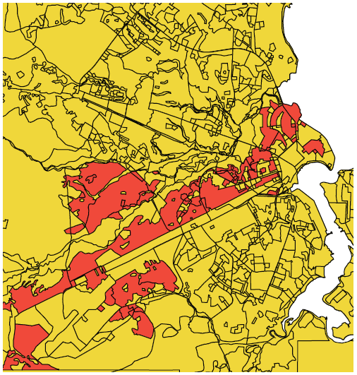
Vector Overlay
Residential areas of Ilala District.
Obtained from polygon intersection.
Input:
Polygon layer with all Ilala wards
Polygon layer with the residential areas.
Data source: Dept. of Urban & Regional Planning and Geo-information Management, ITC

Slide 18




Vector Overlay
CLIP
BY
OVERWRITE
BY
Clip Overlay: Clips down the left hand polygon layer to the generalized spatial extent of right hand polygon layer
Overwrite Overlay: Overwrites the left hand polygon layer with the polygons of the right hand layer

Slide 19
Raster Overlay
The pixel or grid cell values in each map are combined using arithmetic and Boolean operators to produce a new value in the composite map.
Map treated as arithmetic variables and perform complex algebraic functions called map algebra.
3 groups of mathematical operators:
Arithmetic Operators
Comparison Operators
Logical Operators
Conditional Operators

Slide 20
Raster Overlay
Vector overlay is geometrically complicated, and sometimes results in poor operator performance.
Raster overlay performs their computations cell by cell and thus they are fast and not complicated.

Slide 21
Raster Overlay: Arithmetic Operators
Supported Operators are:
Subtraction
Addition
Multiplication
Division
Modulo Division (MOD)
Sine (sin)
Cosine (cos)
Tangent (tan)

Slide 22
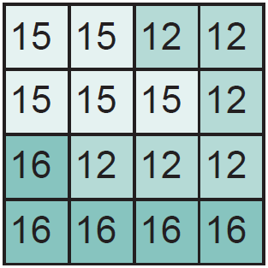
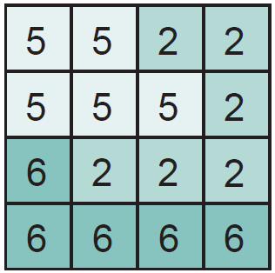
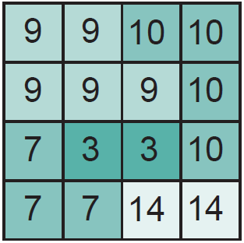
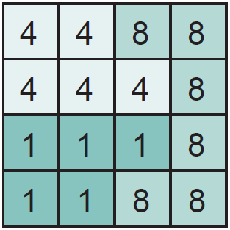
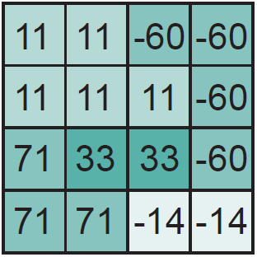
Raster Overlay: Arithmetic Operators
A + 10
C1
A
A+B
C2
B
C3
((A+B)/(A+B))*100

Slide 23
Comparison / Logical Operators
Comparison Operator:
<, <=, =, >, >=, and <>
Logical Operator:
AND
OR
NOT
XOR

Slide 24
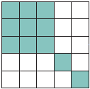
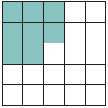
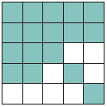
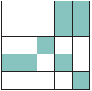
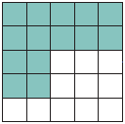
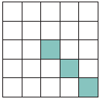
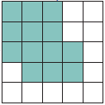
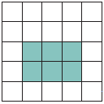
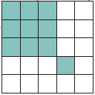
Comparison / Logical Operators
A
A and B
A or B
B
A xor B
A and not B
(A and B) or C
C
A and (B or C)

Slide 25
Buffering

Slide 26
Buffering
process of creating an output polygon layer containing a zone (or zones) of a specified width around an input point, line, or polygon feature.
Buffers are particularly suited for determining the area of influence around features of interest.

Slide 27
Buffering

Slide 28
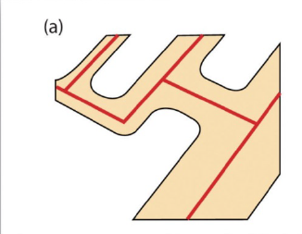
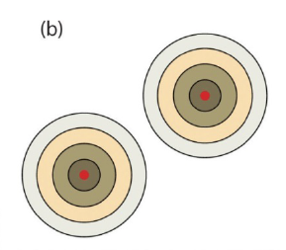
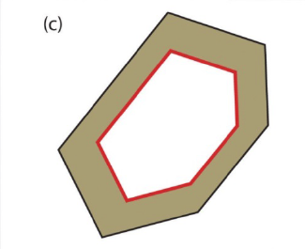
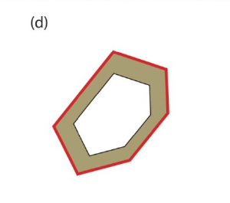
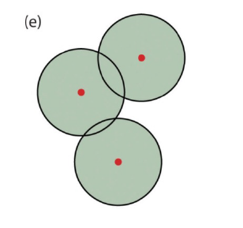
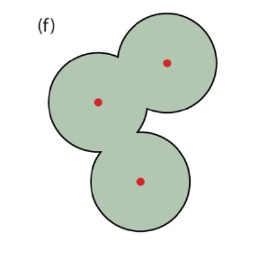
Buffering
Variable Width Buffers
Multiple Ring Buffer
Doughnut Buffer
Setback Buffer
Non-dissolved Buffer
Buffer

Slide 29
Assignment - 6
Write a page about FOSS GIS
Write short notes on LiDAR technology

